Slide 1
Animal Tissues
Class XI B, Chapter 7

Slide 2
Organization of an Organism

Slide 3
A cell is the structural and functional unit of life.
A cell is a mass of protoplasm surrounded by a plasma membrane.
The protoplasm of cell is generally with a spherical nucleus and a variety of cytoplasmic living cell-organelles like the endoplasmic reticulum, mitochondria, Golgi bodies, centrioles, ribosomes, lysosomes, etc.
Each cell organelle performs a specific function.
Somatic cells:
These are general body cells present all over the body except reproductive organs. These cells are responsible for all the bodily activities.
Germ cells:
These are also called ‘sex cells’. These cells are concerned with the reproduction and are present in the reproductive system/organ.

Slide 4
Tissue :
A group of cells similar in form, structure and embryonic origin which coordinate to perform a specific function is called a simple tissue,
while a group of cells, different in their structure and function but coordinating
to perform a specific function, is called a compound tissue.
Various tissues combine together in an orderly manner to form large functional units called organs. Number of organs work in coordination and give rise to organ-system.
The branch of science that deals with the microscopic study of tissues is called
histology.

Slide 5
Epithelial Tissues
( Covering tissues. These tissues are present for protection.)
T I S S U E S
Connective Tissues
( Supporting tissues. These tissues help in binding different body structures.)
Muscular Tissues
Contractile tissues. These tissues help in movements and
locomotion.)
Nervous Tissues
( Conducting tissues. These tissues help in conduction of nerve
impulses.)

Slide 6
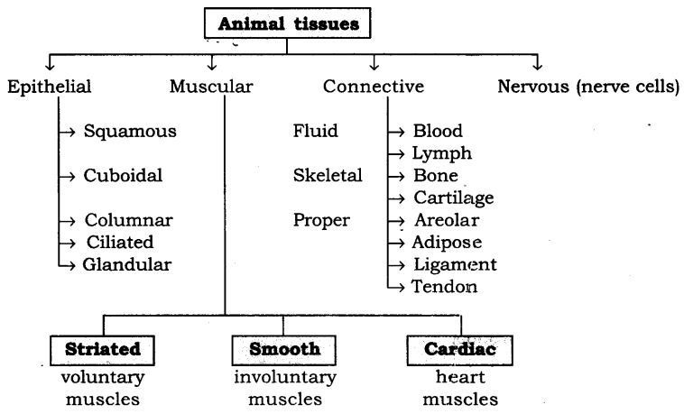

Slide 7
EPITHELIAL TISSUE
General position:
It covers the outer surface of all the organs of the body and also lines the cavities of all the hollow organs of the body.
Structure:
Cells are arranged in one or more layers.
Cells are compactly arranged and there is no or very little intercellular material (matrix) between them.
Cells of the lowermost layer rest on thin, double layered, non-cellular, non-living
basement membrane (or basal lamina)
Cells may originate from any primary germ layer i.e. ectoderm (e.g. epidermis of skin), mesoderm (e.g. coelomic i.e body cavity epithelium), endoderm (e.g. mid gut epithelium).
Cells are non-vascular or avascular, i.e. they lack their own blood supply. These cells get their nutrition from the blood capillaries present in the underlying connective tissue.
Cells have the power of division and regeneration throughout life. The old injured dead cells are sloughed off (removed) regularly.
Free surface of the cells may be smooth, or may have fine hair-like cilia or microvilli.

Slide 8
Simple
EPITHELIAL TISSUE
Compound
Simple Squamous
Simple Cuboidal
Simple Columnar
Ciliated
Non- ciliated
Simple Gandular
Simple sensory
Simple Germinal
Stratified
Transitional

Slide 9
SIMPLE SQUAMOUS EPITHELIUM
Origin:
It is found in the peritoneum of coelom and endothelium (i.e. lining of the blood vessels).
It is also found on the surface of the skin. Structure:
The cells are polygonal in shape, thin, delicate and flat.
The nucleus is centrally placed. They appear like flat tiles when viewed from the top and so they are also called pavement epithelium.
Functions:
Filtration and diffusion of material.
Protection of skin from micro-organisms and foreign particles.

Slide 10
SIMPLE CUBOIDAL EPITHELIUM
Origin:
It is generally found in the thyroid gland and kidney.
Structure:
The cells are cube shaped, with centrally placed round or spherical nucleus.
Functions:
They play an important role in absorption and secretion.

Slide 11
SIMPLE COLUMNAR EPITHELIUM
Origin:
It makes the inner lining of stomach,intestine and other internal organs.
Structure:
The cells are tall, pillar-like with anterior free end that is broader than the posterior narrow end resting on the basement membrane.
Nucleus is oval or elliptical and is placed
near the basal end

Slide 12
CILIATED COLUMNAR EPITHELIUM
Origin:
It is found in the upper respiratory tract,
fallopian tube of vertebrates.
Structure:
The cells are tall, pillar-like with anterior free end that is broader than the posterior narrow end resting on the basement membrane.
The anterior free end shows presence of large number of thin protoplasmic extension called cilia, which are seen rising from the basal granules.
Nucleus is oval and placed at the basal end. Functions:
Since cilia are capable of vibratory movement, they are able to remove foreign particles from the surface. Cilia help in the movement of non-motile ovum.

Slide 13
NON- CILIATED COLUMNAR EPITHELIUM
Structure:
These are without cilia at their anterior free end and hence called non-ciliated columnar epithelium.
Columnar cells at their apical region show presence of finger like protoplasmic projections called microvilli.
Functions:
Microvilli help in increasing the surface area of absorption which is the main function of non-ciliated columnar epithelium.

Slide 14
SIMPLE GLANDULAR EPITHELIUM
These are specialized epithelial cells capable of synthesizing substances like enzymes, hormones, sweat, oil, etc.
These secretions are carried into ducts (tubes) on the surface or into blood.
The structure formed by these specialized epithelial cells is commonly called a GLAND
Glands are further classified as:
Endocrine glands
Exocrine glands
Heterocrine Gland

Slide 15
SIMPLE GLANDULAR EPITHELIUM
Endocrine Glands:
These glands pour their secretion directly into the blood stream. Such glands lack
ducts and are thus called ductless glands.
e.g.: pituitary, thyroid, parathyroid, ovary, testis, adrenal, islets of Langerhans.
Exocrine Glands:
These glands are with ducts. Their secretion is carried by means of a duct or tube to the site of action. They are responsible for body secretions.
e.g.: tear glands, salivary glands, gastric and intestinal glands.
Heterocrine Gland- Mixing of both gland ,Pancreas

Slide 16
Exocrine Glands

Slide 17
COMPOUND EPITHELIUM
1. STRATIFIED EPITHELIUM
2. TRANSITIONAL EPITHELIUM

Slide 18
CONNECTIVE TISSUE
Origin: -Arise from the mesoderm of the embryo.
Most abundant type of animal tissue
Structure:
The connective tissues consist of variously shaped cells lying wide apart in a large, amount of non-living intercellular or extracellular material called the matrix.
The matrix is also called ground substance. It is usually secreted by the connective tissue cells themselves.
This ground substance permits diffusion of food materials, water, gases and wastes to and from the cells.
Thus, connective tissue usually comprises of two components: matrix and cells.
The nature and proportion of these two components vary in different kinds of connective tissues.
Almost all connective tissues are highly vascular in nature
In all connective tissues, except blood, the cells secrete fibres of structural proteins called collagen or elastin.

Slide 19
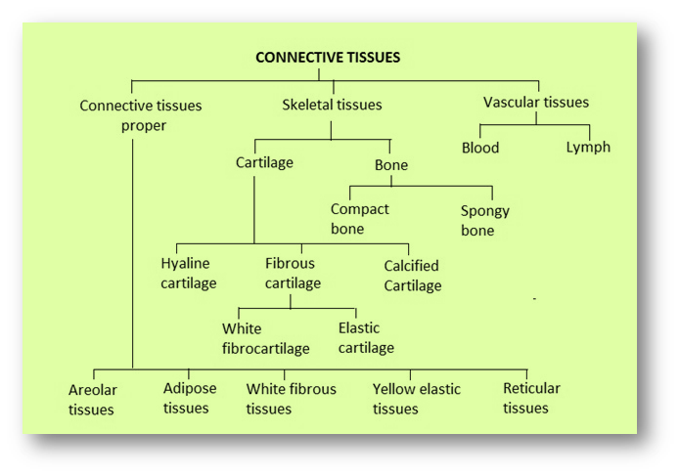

Slide 20
CONNECTIVE TISSUE
Connective tissue proper
Fluid connective tissue
Skeletal connective
tissue
Areolar
Adipose
White fibrous
Yellow elastic
Reticular.
Cartilage
Bone
1. Blood
2. Lymph

Slide 21
CONNECTIVE TISSUE

Slide 22
Connective tissue proper
Areolar connective tissue
Origin:
It is found below the skin, muscles and bones.
Functions:
The areolar tissue, also called loose connective tissue, is essentially connective in function.
It fixes the skin with the muscles, attaches the blood vessels and nerves with the surrounding tissues, fastens the peritoneum to the body wall and viscera and keeps the muscle fibres together.

Slide 23
Connective tissue proper
Areolar connective tissue
Structure: The transparent jelly-like, sticky matrix contains numerous fibres and cells and abundant mucin.
Fibres: The fibres are white and yellow.
White fibres:
unbranched, wavy and arranged in bundles.
also called collagen fibres as they contain proteinous substance called collagen
These collagen fibres give tensile strength to the tissue. Collagen fibres are formed at the site of injury for tissue repair (healing).
Yellow fibres:
Thin, slender and singly arranged.
These are flexible, elastic and branched, the branches joining with one another to form an irregular but large network.
They possess elastic property due to the presence of a protein called elastin.

Slide 24
Connective tissue proper
Areolar connective tissue
Cells: The cells in the matrix are of 4 main kinds: Fibroblasts, macrophages, mast cells and adipocytes
Fibroblasts:
Main cells of the areolar tissue. They are large, flat and star-shaped cells with long and branched processes.
They secrete the matrix and the material of which the fibres are formed (both white and yellow fibres).
Fibroblasts migrate to the site of injury and secrete more fibres to seal off the wound.
Macrophages or Histiocytes:
The macrophages are almost as numerous
as the fibroblasts.
They are large, long-lived and irregular cells.
They engulf the microbes, foreign particles and damaged cells.
Hence, they are phagocytic in action.

Slide 25
Connective tissue proper
Areolar connective tissue
Mast Cells:
The mast cells are also called mastocytes
and they are small oval cells in mammals.
They produce heparin and histamine.
Heparin prevents blood clotting in the uninjured vessels.
Histamine is useful in dilating blood vessels, an inflammatory response to injury or infection. Histamine is also involved in allergic reactions. Its release from the mast cells helps in body defence by attracting the phagocytes to the site of injury.
Adipocytes:
These are useful in storage of fats.

Slide 26
Connective tissue proper
Adipose connective tissue
Origin:
The adipose tissue is found in the subcutaneous tissue (under the skin), in the covering of the heart and around the blood vessels and kidneys.
It also forms the yellow bone marrow.
Functions:
Adipose tissue is primarily a food reserve.
The subcutaneous fat prevents heat loss from the body, particularly in polar animals and also rounds off the body contour (shape).
It forms a shock absorbing cushion around the kidneys and the eyeballs.
It also produces the blood corpuscles.
Structure:
Adipose tissue is found in association with the areolar
connective tissue.
It is modified areolar tissue consisting of a large number of adipocytes i.e. cells specialised for fat storage. A fat cell first develops in it small fat droplets, which later fuse to form a large fat globule. These globules push the cytoplasm with its organelles to the periphery and the nucleus to one side.

Slide 27
Connective tissue proper
Adipose connective tissue
White Adipose Tissue:
These appear opaque due to the presence of a large number of adipocytes.
It is commonly seen in adults.
Brown Adipose Tissue:
These are reddish brown in colour due to the large number of blood vessels.
It is mostly found in developing foetus and infants.

Slide 28
Connective tissue proper
White fibrous tissue
White Fibrous Tissue:
The white fibrous tissue is especially rich in white collagen fibres.
These are similar to but thicker than those found in the areolar tissue.
This tissue is very tough and inelastic. It appears as cords or sheets.
As cords, the white fibres run parallel to form cords called tendons.
Tendons connect the skeletal muscles with the bones.
Tendons:
They are specialized extensions or prolongations of muscles.
They are formed of bundles of collagen fibres (white fibres).
At one end, they are formed from the core of the muscles and the other end is attached to a bone.
Some of the tendons are – Achilles tendon,
hamstring tendon.
They play an important role in various movements.
As sheets, it occurs in the pericardium of the heart, dura mater of the brain and spinal cord, capsule of the kidney, etc.

Slide 29
Connective tissue proper
Yellow elastic tissue
Yellow Elastic Tissue:
The yellow elastic tissue consists mainly of a loose network of yellow elastic fibres.
These elastic fibres are much thicker but similar to those of areolar tissue.
This tissue combines strength with great flexibility. It also has 2 forms: cords and sheets.
The cords formed by this tissue are called ligaments.
Ligaments serve to bind the bones together.
Ligaments:
They are formed of bundles of yellow fibres
They bind two different bones at the joints.
They play a very important role in preventing dislocation of bones and at the same time providing flexibility to joints.
As sheets formed by this tissue, they occur in the walls of the blood vessels, lungs and bronchioles.
Recovery of these organs after expansion is due to this tissue’s presence.

Slide 30
Connective tissue proper
Reticular Connective tissue
RETICULAR TISSUE :
The reticular tissue consists of star- shaped reticular cells, the protoplasmic processes of which join to form a cellular network.
Reticular fibres are superimposed on the reticular cells. They are composed of a protein called reticulin.
They are branched and inelastic.
This tissue forms the supporting framework of lymph glands, spleen and bone marrow.
The reticular cells are phagocytic and form defence mechanism of the body.

Slide 31
Skeletal Tissue
Cartilage
The cartilage is a solid, semi-rigid connective tissue. It is tough, flexible tissue which forms the endoskeleton in large number of vertebrates.
Structure:
The cartilage is enclosed in a sheath of white fibrous tissue called perichondrium. It consists of blood vessels and nerve fibres.
The perichondrium encloses a semi-solid matrix called
chondrin.
Towards the periphery or the inner margin of the perichondrium, a layer of small immature cartilage cells called chondroblasts are seen. The matrix is secreted by the chondroblasts.
A chondroblast lies in a fluid-filled space, the cartilage
lacuna, in the matrix.
During growth of the cartilage, the chondroblasts divide and the cells formed by division keep lying in groups of two or more in the same lacuna

Slide 32
Skeletal Tissue
Cartilage
In the matrix near the perichondrium, the chondroblasts are small and young and they lie close together. Later, they become large, rounded, and mature and occur in groups. Here, they are called chondrocytes.
These chondrocytes are enclosed within lacunae and are seen scattered in the matrix.
Each lacuna contains 2 to 8 chondrocytes.
The exchange of materials (nutrients) between the chondrocytes and the matrix takes place with simple diffusion from blood vessels present in the perichondrium.
Depending on the nature of the matrix, cartilage is classified as:
Hyaline Cartilage
Fibrous Cartilage
Elastic Cartilage
Calcified Cartilage

Slide 33
Skeletal Tissue
Cartilage
Hyaline cartilage
Hyaline Cartilage:
It is the weakest of the four types or cartilages.
Origin: It is found at the ends of long bones, anterior ends of ribs, nose tip, larynx, and bronchial tree, foetal and embryonic skeleton.
Structure: It is compressible and elastic in nature. It is surrounded by perichondrium. The matrix, i.e. chondrin, is bluish-white and gel-like (transparent). It contains very fine collagen fibres and chondrocytes (2 to 8 in each lacuna).
Functions:
It provides flexibility and supports the body.
It helps in reducing friction.
It also acts as a good shock absorber.

Slide 34
Skeletal Tissue
Cartilage
Fibrous cartilage
Fibrous Cartilage:
It is the strongest and the most rigid cartilage in the body.
Origin: It is found in the pubic symphysis, intervertebral discs, etc.
Structure: It is not surrounded by the perichondrium. It has little matrix and abundant white collagen fibres. This combines the flexibility of the cartilage with the firmness of the white fibres.
Functions:
It acts as a cushion in the intervertebral discs.
In the pubic symphysis
It helps to support and aids fusion of different organs of the body.

Slide 35
Skeletal Tissue
Cartilage
Elastic Cartilage
Elastic Cartilage:
Origin:
It is found in the epiglottis (lid on top of the larynx), external ear (auricle), trachea etc.
Structure:
It is surrounded by perichondrium. The matrix (chondrin) contains a thread-like network of elastic fibres.. It has abundant network of yellow fibres in addition to white fibres. Chondrocytes are few in number and are seen encircled with elastic fibres. It is opaque and yellowish in appearance. It readily recovers its shape after distortion.
Functions:
It gives support and maintains shape of the body.

Slide 36
Skeletal Tissue
Cartilage
Elastic Cartilage
Calcified Cartilage:
It is formed due to deposition of various salts in the matrix.
Due to this deposition, the cartilage becomes very hard and inelastic and loses it flexibility.
This condition is found in old age where the joints lose their mobility.
It is also found in the suprascapula of the frog and the vertebrae of sharks.

Slide 37
Hyaline Cartilage | Fibrous Cartilage | Elastic Cartilage
1) It is bluish green, translucent in appearance. | 1) It is whitish, opaque in appearance. | 1) Is yellowish, opaque in appearance.
1) Has fewer, very thin white fibres in the matrix. | 2) Has an abundant white fibres in the matrix. | 2) Has an abundant yellow fibres in the matrix.
2) It is flexible. | 3) It is firm. | 3) It is very flexible.
3) Perichondrium is present. | 4) Perichondrium is absent. | 3) Perichondrium is present.
3) Occurs in sternal ribs, tracheal and bronchial rings, laryngeal wall and nasal septum. | 4) Occurs in intervertebral discs and pubic symphysis. | 4) Occurs in pinna, external auditory meatus, nose tip and epiglottis.

Slide 38
Skeletal Tissue
Bone
BONE :
Bone is the hardest tissue in the body.
Bone is the main constituent of the skeleton. Bone shows the presence of hard, solid, calcified matrix called ossein.
The hardness is due to deposition of inorganic mineral salt called hydroxyl- apatite [ Ca₁₀ (PO₄)₆ (OH)₂ ].

Slide 39
Skeletal Tissue
Bone
Structure:
Bone is enclosed in a thin layer of white fibrous connective tissue (i.e. collagen fibre) called periosteum.
Blood vessels and nerves pierce through the periosteum. The periosteum is internally lined by endosteum which surrounds the marrow cavity.
The matrix is arranged in concentric circles called lamellae.
These lamellae contain a large number of living cells called osteoblasts or osteocytes which are present in a fluid filled cavity called lacuna.
Osteoblasts are active bone cells and osteocytes are inactive bone cells. Each lacuna has fine cytoplasmic extensions called canaliculli which pass through the lamellae and makes connection with the adjacent lacunae

Slide 40
Skeletal Tissue
Bone
The structural unit of bone is the Haversian system or osteon.
Presence of a Haversian system is the characteristic of a mammalian bone.
Haversian system shows a Haversian canal in the centre.
Haversian canal consists of blood vessels of arteries and veins, lymph vessels and nerves as well.
Lacunae containing osteoblasts or osteocytes are arranged in concentric circles around the Haversian canal.
The two adjacent Haversian systems are interconnected by transverse channels, the Volkmann’s canal.

Slide 41
Skeletal Tissue
Bone
Functions:
It is the supporting and protective tissue of vertebrates which protects the internal soft and delicate tissues.
Besides providing support, bones have a metabolic and protective role too.
It forms the base for attachment of muscles.
In long bones, the yellow marrow cavity helps in storage of reserve food material.
The red marrow cavity in the long bones is useful in haemopioesis

Slide 42
Skeletal Tissue
Bone
Spongy bone:
Origin:
It is seen in the expanded ends
(epiphyseal region) of long bones.
Structure:
The matrix or ossein is web-like containing columns of bones called trabeculae with many small spaces between them. These spaces contain a soft tissue called red bone marrow which is responsible for heamopiosis. It lacks the Haversian system.
Functions:
The spongy bones provide considerable strength with minimum of weight.
Compact bone:
Origin: It is seen in the shaft (diaphysis) of long bones.
Structure: The matrix is hard, solid, and dense and without spaces in-between. It is filled with a fatty tissue called the yellow marrow which stores fat cells. It has many Haversian systems.
Functions: The compact bone stores fat and produces blood corpuscles in emergencies.

Slide 44
Blood is a body fluid in humans and other animals that delivers necessary substances such as nutrients and oxygen to the cells and transports metabolic waste products away from those same cells. In vertebrates, it is composed of blood cells suspended in blood plasma.

Slide 45
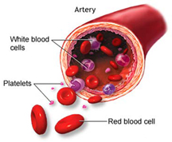
Blood

Slide 47
what’s in
digested food
red blood cells
white blood cells
BLOOD
oxygen
waste (urea)
carbon dioxide
platelets
plasma
hormones

Slide 48
Function Blood
Deliver O2
Remove metabolic wastes
Maintain temperature, pH, and fluid volume
Protection from blood loss- platelets
Prevent infection- antibodies and WBC
Transport hormones

Slide 49
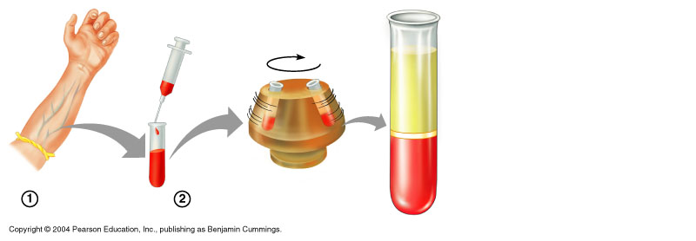
Blood
Plasma-55%
Buffy coat-<1%
Formed elements-45%

Slide 50
Blood Plasma Components-55%
90% Water
8% Solutes:
Proteins
Albumin (60 %)
Alpha and Beta Globulins
Gamma Globulins
fibrinogens
Gas
Electrolytes

Slide 51
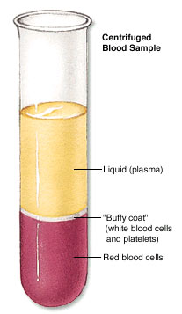
Plasma
It also contains useful things like;
carbon dioxide
glucose
amino acids
proteins
minerals
vitamins
hormones
waste materials
like urea.
A straw-coloured liquid that carries the cells and the platelets which help blood clot.
PLASMA-----PROTEIN (Clotting Protein) = SERUM

Slide 52
Blood Plasma Components
Organic Nutrients
Carbohydrates
Amino Acids
Lipids
Vitamins
Hormones
Metabolic waste
CO2
Urea

Slide 53
Buffy Coat- <1%
Leukocytes
Platelets

Slide 54
Formed Elements of the Blood-45%
1.Erythrocytes (red blood cells)
2.Leukocytes (white blood cells)
3.Platelets (thrombocytes)

Slide 55
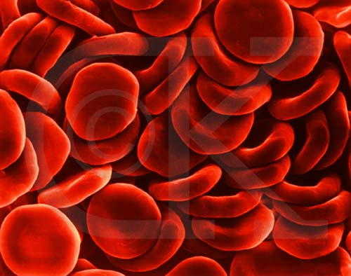
Erythrocytes

Slide 56
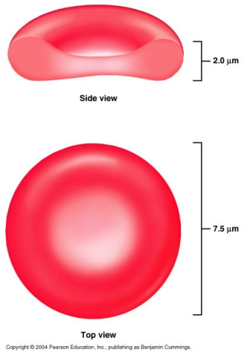
Erythrocyte→7.5μm in dia
• Anucleate- so can't reproduce; however, repro in red bone marrow
• Hematopoiesis- production of RBC
• Function- transport respiratory gases
• Hemoglobin- quaternary structure, 2 α chains and 2 β chains
• Lack mitochondria. Why?
• 1 RBC contains 280 million hemoglobin molecules
• Men- 5 million cells/mm³
• Women- 4.5 million cells/mm³
• Life span 100-120 days and then destroyed in spleen (RBC graveyard)

Slide 57
Erythrocytes or (RBC)
Most abundant of all the cells in blood.
RBCs are devoid of nucleus in most of the mammals and are biconcave in shape.
A healthy individual has 12-16 gms of haemoglobin in every 100 ml of blood.
They are destroyed in the spleen (graveyard of RBCs),Liver & bone marrow.
Haemolysis of RBC formed bile pigments i.e bilirubin & biliverdin.
Each RBC takes about 250,000 circuits before hemolysis (per second 1%)

Slide 58
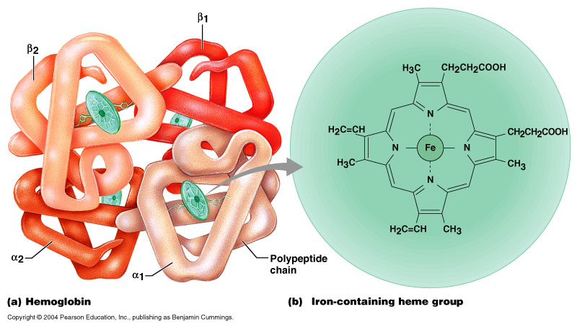
Hemoglobin

Slide 59
Leucocytes
Leucocytes are also known as white blood cells (WBC) as they are colourless due to the lack of haemoglobin.
They are nucleated and are relatively lesser in number which averages 6000-8000 mm–3 of blood.
Leucocytes are generally short lived.

Slide 60
Types of Leukocytes
4,000-11,000 cells/mm ³
.
Granulocytes
Neutrophils- 60-65%
Eosinophils- 2-3%
Basophils- 0.5-1%
Agranulocytes
Monocytes- 6-8%
Lymphocytes- 20-25%

Slide 61
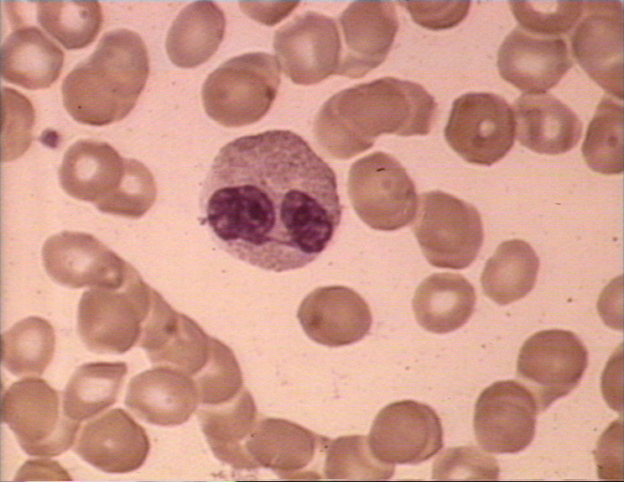
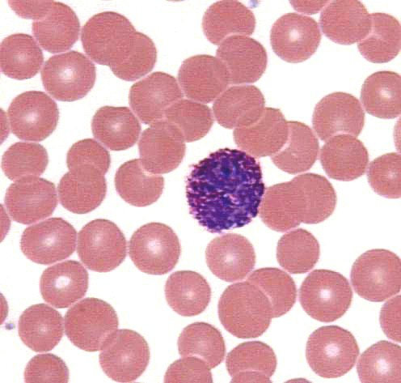
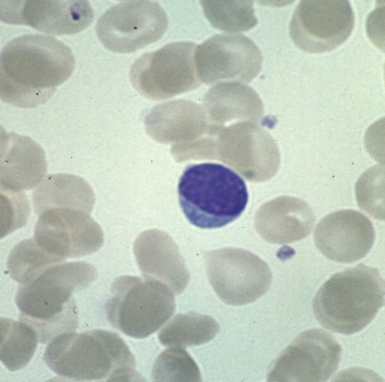
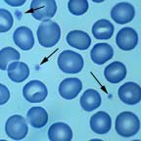
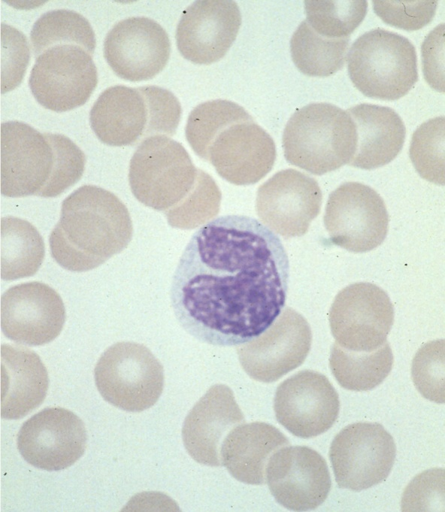
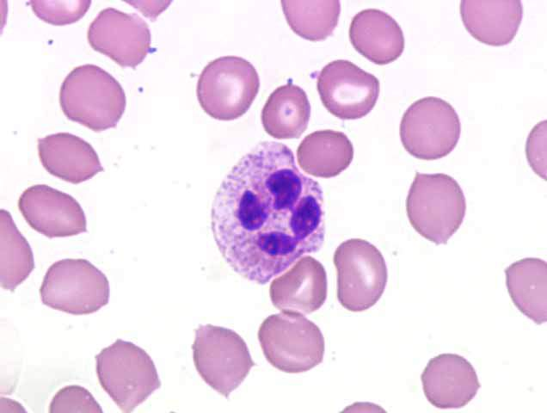
Eosinophil
Lymphocyte
Basophil
Neutrophil
platelet
Monocyte

Slide 62
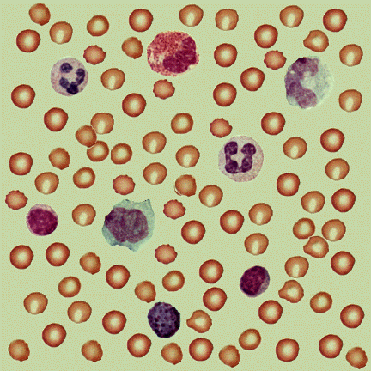
eosinophil
neutrophil
monocyte
RBC
neutrophil
monocyte
lymphocyte
lymphocyte
basophil

Slide 63
FUNCTIONS
Neutrophils and monocytes are phagocytic cells which destroy foreign organisms entering the body.
Basophils secrete histamine, serotonin, heparin, etc., and are involved in inflammatory reactions.
Eosinophils resist infections and are also associated with allergic reactions.

Slide 64
Lymphocytes
Lymphocytes (20-25 per cent) are of two major types – ‘B’ and ‘T’ forms.
Both B and T lymphocytes are responsible for immune responses of the body.

Slide 65
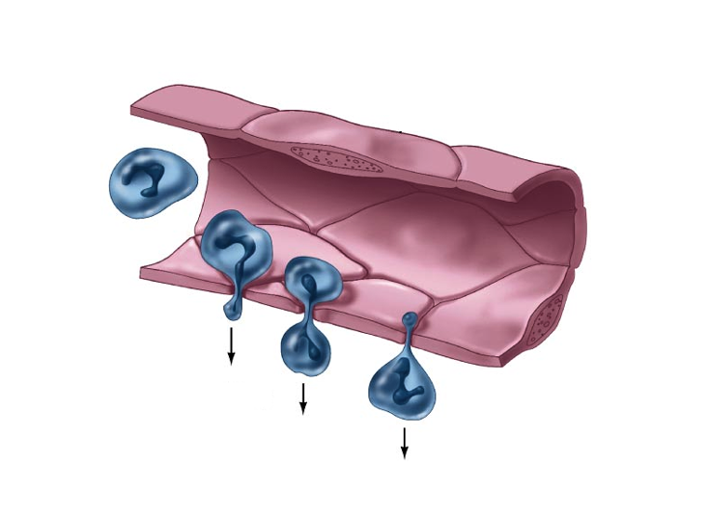
Diapedesis
Leucocytes are capable of coming out of blood capillaries by amoeboid movement is called DIAPEDESIS

Slide 66
WBC Diseases
Leukopenia
Abnormally low WBC count—drug induced
Leukemias
Cancerous conditions involving WBCs
Named according to the abnormal WBC clone involved
Mononucleosis
highly contagious viral disease caused by Epstein-Barr virus; excessive of agranulocytes; fatigue, sore throat, recover in a few weeks

Slide 67
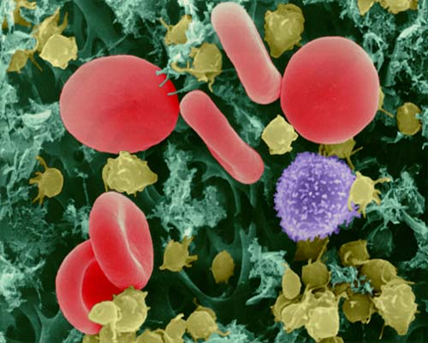
Platelets
Smallest part of blood
No nucleus
Live 2-4 days
Involved in clotting of blood

Slide 68
Platelets
Also called thrombocytes
Small fragments of megakaryocytes
(special cells in the bone marrow)
Granules contain serotonin, Ca²⁺, enzymes, ADP, and platelet-derived growth factor (PDGF)
Blood normally contains 1,500,00-3,500,00 platelets mm–3.
Platelets can release a variety of substances most of which are involved in the coagulation or clotting of blood.

Slide 69
Factor Common Name
Number
I Fibrinogen
II Prothrombin
III Tissue Factor
IV Ca2+
V Proaccelerin
VII Proconvertin
VIII Antihemophilic Factor
IX Christmas Factor
X Stuart Factor
XI Plasma thromboplastin antecedent
XII Hageman factor
XIII Fibrin Stabilizing Factor

Slide 70
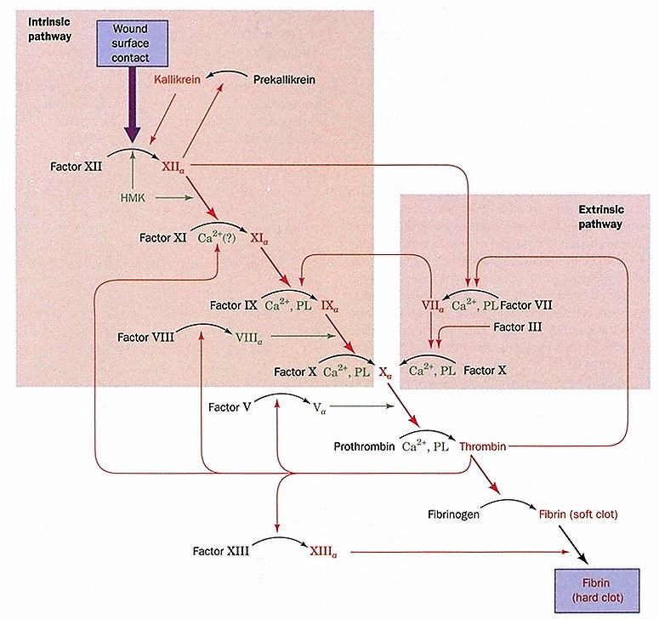

Slide 71
Hemostasis- stoppage of bleeding
Platelets: 250,000-500,000 cells/mm³
Tissue Damage
Platelet Plug
Clotting Factors

Slide 72
MUSCULAR TISSUE
Origin:
The muscle tissue arises from the embryonic mesoderm. It makes up about 40% of a mammals body weight.
General Structure:
Muscular tissue is made up of thin, elongated, contractile muscle fibres; hence it is also called contractile tissue.
The fibres have the ability to contract due to the presence of protein filaments of myosin and actin. Hence, they play an important role in locomotion and movement.
Muscle fibres are thin, elongated cells with one or many nuclei.
The plasma membrane or the outer covering of a muscle fibre is called sarcolemma.
The cytoplasm of a muscle fibre is called sarcoplasm. The sarcoplasm is largely occupied by longitudinal, parallel protein threads, called myofibrils, arranged along the axis of the fibre. These protein threads contain myosin and actin.
The muscular tissue is innervated (supplied) with nerve fibres. They are vascular and are supplied with blood vessels which carry nutrients and take away the metabolic waste.

Slide 73
Functions:
It brings about movements of the body parts and locomotion of the organism.
Many muscles support bones and other structures.
Facial expressions and gestures also depend on muscles.
Muscles are responsible for the heartbeat, for the flow of blood through the vessels, for the passage of food through the alimentary canal, for the flow of air through the respiratory tract, for the production of sound, and for the release of secretions and waste products through the ducts.
Muscles are required for taking food, passing urine and faeces, mating, delivering a baby, feeding a young one, maintenance of equilibrium and a favourable resting posture.

Slide 74
Types of Muscle Tissues:
Based on their structure, location and function, the muscles tissue is categorized into three types:
Striated or striped muscles
Non-striated or unstriped or smooth muscles
Cardiac muscles

Slide 75
Muscular Tissue
Striated Muscle
Location:
- These are seen attached to bones in the head, trunk and limb region and so they are also called skeletal muscles.
Structure:
presence of cross striations in the form of light and dark bands.
large number of peripherally placed nuclei.
fibres are placed parallel to one another and are connected together by means of connective tissue to form small muscle bundles.
Muscle fibres contain a large number of myofibrils within the sarcoplasm covered with a thick membranous sheath called sarcolemma.
These myofibrils are marked by the presence of distinct cross-striations in the form of alternately arranged light and dark bands. Hence they are called striated muscle fibres
The light band is also called the “I-band” or Isotropic band. They allow the light to pass through them and so appear light.
A narrow dark line is seen in the light band and is called “Z-line” or Krause’s membrane.
The dark band or “A-band” or Anisotropic band does not allow light to pass through and so it appears dark. The dark band is interrupted with narrow light line called “H-Line” or Hensen’s line.
The portion between two “Z-lines” is called sarcomere.

Slide 76
Muscular Tissue
Striated Muscle

Slide 78
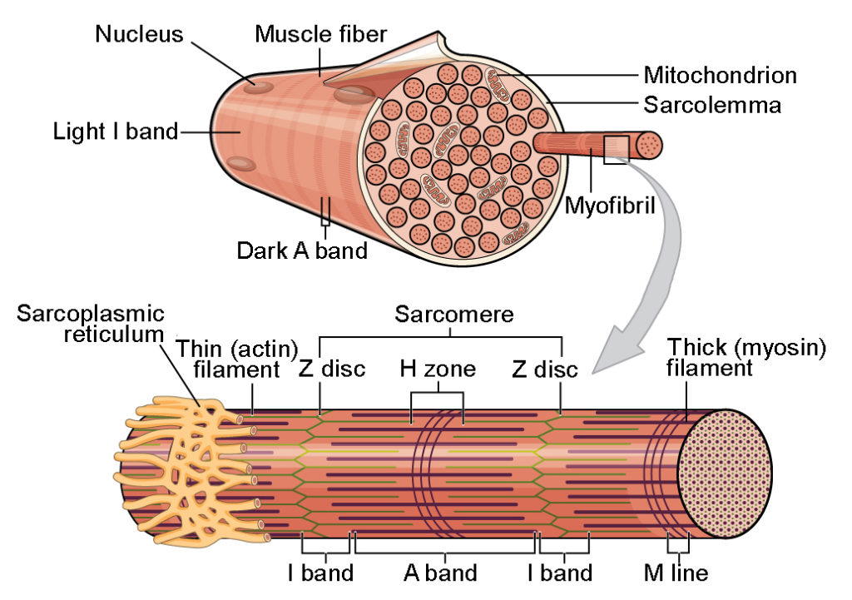

Slide 79
Muscular Tissue
Smooth Muscle
Origin:
These are seen in the walls of all visceral organs like stomach, intestine, reproductive and urinary systems etc.
Therefore, they are also called visceral muscles. They are involuntary in nature, i.e. their contractions are not controlled by our will
Structure:
elongated, slender and spindle shaped with tapering ends. arranged in sheets or layers and are bound by sarcolemma.
Cross-striations are absent within the sarcoplasm. centrally placed, single, large and oval nucleus.
Each muscle fibre contains many fine
contractile myofibrils arranged longitudinally.
These myofibrils are innervated by the autonomous nervous system (sympathetic and parasympathetic).

Slide 80
Muscular Tissue
Smooth Muscle
Functions:
These muscle fibres are involuntary in nature.
They undergo prolonged but slow contractions and relaxations.
The frequency and intensity of contractions
varies.
They are responsible for the peristaltic movements which help in the passage of food in the digestive tract

Slide 81
Muscular Tissue
Cardiac Muscle
Origin:
These involuntary muscles are found only in the wall of the heart or in the myocardium.
It also occurs in the pulmonary veins and the
superior vena cava.
The unique ability of the heart is to generate its own wave of excitation that can pass directly from fibre to fibre.
Structure:
An individual fibre is intermediate between striated and un-striated muscle fibres.
These are short, branched fibres with ill-defined sarcolemma.
The fibres are uni-nucleated but as they are joined together by neighbouring cardiac muscle fibres.
Thus they appear multi-nucleated.
The branches of different fibres join to form a network.
The place where these fibres unite is marked by the presence of special zig-zag junctions called intercalated discs. Intercalated discs are the unique feature of cardiac muscles. They are formed by transverse thickenings of the sarcolemma. They show the presence of alternate light and dark bands.
The contraction of the cardiac muscles is initiated from a particular point in the heart itself which is known as the pacemaker. Such a type of a heart is called myogenic (i.e. of muscular origin).
Cardiac muscles in some animals are sometimes seen innervated (supplied) with nerve fibres which are responsible for triggering the contraction. This type of a heart is known as neurogenic (i.e. controlled by nervous tissue).

Slide 82
NERVOUS TISSUE
Origin:
The nervous tissue arises from the ectoderm of the embryo.
Special Properties:
The cells of the nervous tissue (i.e. neurons) provide the quickest means of communication within the body and help the body to give response to the external stimulus.
Thus, the cells of the nervous tissue (i.e. neurons) are considered as impulse generating and impulse conducting unit.
Neurons possess two important basic properties: excitability and conductivity.
Excitability is excitation by external stimulus by changing the action potential of their membrane.
Conductivity is to carry a wave of electric impulse from the dendron to axon.
General structure:
Nervous system is made up of nervous tissue.
Nervous tissue is composed of nerve cells or neurons and supportive cells called neuroglia or glia cells.

Slide 83
Nervous Tissue
Structure
Neuron is covered by neurilemma and is made up of two distinct regions: cyton and cytoplasmic extensions
Cyton or cell body is also called perikaryon or soma
contains granular cytoplasm with large number of network of neurofibrils, various cell organelles like mitochondria, Golgi complex, RER (Rough Endoplasmic Reticulum) and centrally placed nucleus.
The granules present in cytoplasm are conical, rich in RNA and are involved in protein synthesis. These are called Nissl's granules
cytoplasmic extensions seen arising from the cyton namely: dendrons and axon.

Slide 84
Nervous Tissue
Structure
Dendrites are thin, small cytoplasmic extensions seen in the periphery of the cyton.
These are many in number and break into numerous fine branches which help to carry impulse towards the cell body and are provided with few of the neurofibrils.
Axon is the single, longest cytoplasmic process useful in conduction of impulse away from the cell body. It is lined by axonal membrane and encloses cytoplasm called axoplasm.
It contains large number of mitochondria, RER and neurofibrils but lacks Nissl's granules and Golgi complex.
The axon, throughout the length is wrapped by Schwann cells. The Schwann cells secrete a lipid covering which forms an insulating myelin sheath.
The terminal end of the axon in both myelinated and non-myelinated neurons shows presence of many swollen knob-like structures called telodendrons
They are filled with neurosecretory material (acetylcholine and adrenaline) which acts as a neurotransmitter

Slide 85
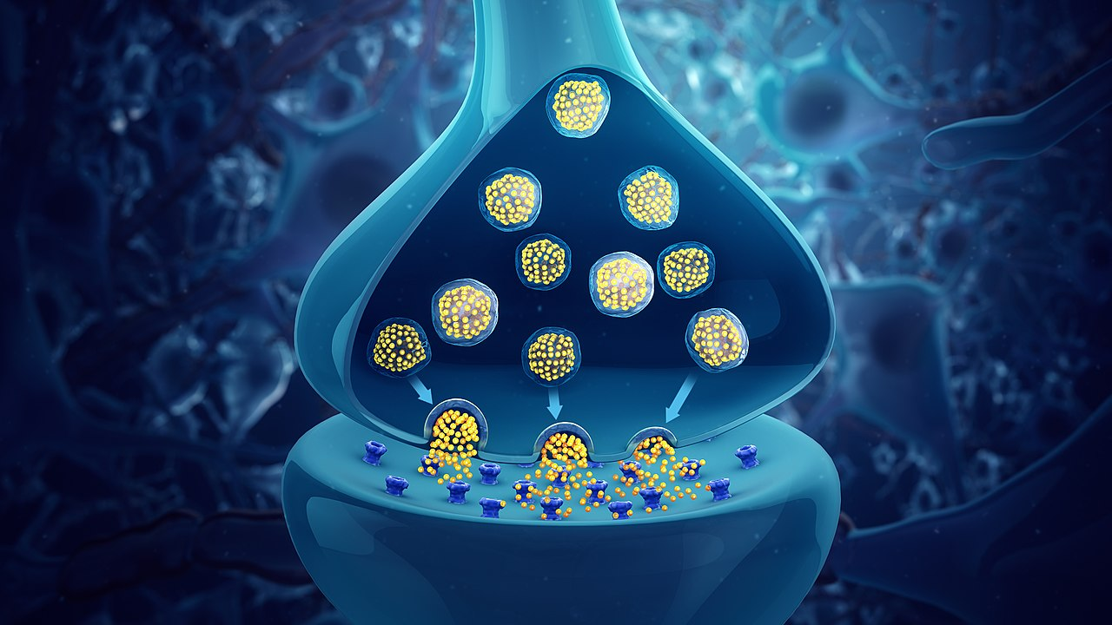

Slide 86
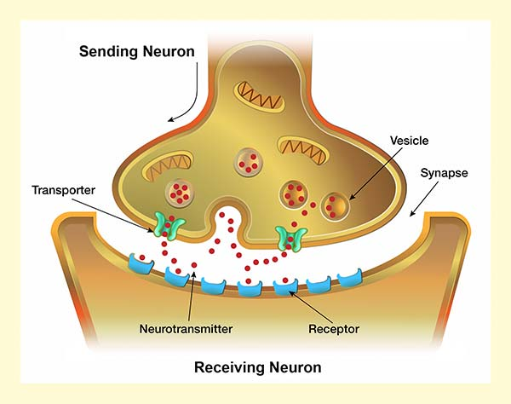

Slide 87
Nervous Tissue
Synapse
Stimuli reach the cyton or cell body through dendrites and the impulses are passed on from cyton towards axons.
The telodendron of the axon one neuron comes in close functional apposition between dendrites of another neuron.
This type of functional contact between axons and dendrites of two different neurons is called a synapse.
The impulse from one neuron passes to another neuron only through a synapse.
The space enclosed between the telodendron of the first neuron and the cyton of second neuron forms synaptonemal complex.
In this region the end bulb of the first neuron releases its content i.e. neurotransmitter, on excitation.
The impulse is passed usually in a a “one-way" direction through this complex.

Slide 88
Nervous Tissue
Neuroglia cells:
In the central nervous system, the inter-neuronal space is filled with large amount of supporting non-nervous cells called neuroglia cells (or microglial cells or oligodendrocytes).
These cells are more in number as compared to the neurons.
They are capable of regeneration and division which is lacking in nerve cell.
The glial cells are useful in supporting the neurons, providing nourishment of neurons and provide protection to neurons by engulfing foreign particles (phagocytosis).
Nerves consist of several bundles (fasciculi).
Each bundle is made up of many nerve fibres.
Each fibre in a fasciculum or bundle is surrounded and held to the others by a thin layer of connective tissue called endoneurium.
Each bundle or fasciculum is enclosed by a coat of white fibrous tissue termed perineurium.
Each nerve consisting of all these bundles are enveloped by another coat of white fibrous tissue called epineurium.)

Slide 89
Neurons
Classification
Neurons
Structure
Function
Medullary sheath
Unipolar
Bipolar
Multipolar
Sensory
Motor
Medullated
Non- medullated

Slide 90
Neurons
Structure
Depending on the number and arrangement of cytoplasmic extensions, the neurons are classified as:
Unipolar neuron has single process. It is also called monopolar neuron.
Bipolar neurons have two processes originating from opposite poles of the cyton.
Multipolar neurons have more than two
processes.

Slide 91
Neurons
Function
Sensory neuron responds to external stimulus and carries impulse towards the central nervous system.
The axonal parts of sensory neurons terminate in the intermediate neurons which are seen in brain and spinal cord. These are stimulated by the impulses that are received from the sensory neuron.
Motor neurons carry impulses from the central nervous system towards the effector organ which brings about the response.

Slide 92
Neurons
Medullary sheath
Myelinated or Medullated nerve fibre:
Schwann cells secrete an insulating fatty layer around the nerve fibre which forms myelin sheath.
It is interrupted at regular intervals called Nodes of Ranvier.
A thin delicate membrane called neurilemma
surrounds the axon.
Cranial nerves of vertebrates are of this type.
Myelinated or Medullated nerve fibres are useful in conducting impulse at a faster rate.
As the impulse jumps from one Node of Ranvier to another, it is called Saltatory conduction.
Non-myelinated or non-medullated nerve fibre:
The axon of this nerve fibre lacks the myelin sheath as the Schwann cells present around the nerve fibre does not secrete the sheath.
These are present in the autonomous nerves of vertebrates and invertebrate nervous system.
These nerve fibres also help in the conduction of impulses but at much slower rate as compared to myelinated nerve fibres.

Slide 93
The End

